Slide 1

Enzyme-Constrained GEMs of microbial and human metabolism
PhD student Iván Domenzain 2020-02-09

Slide 2
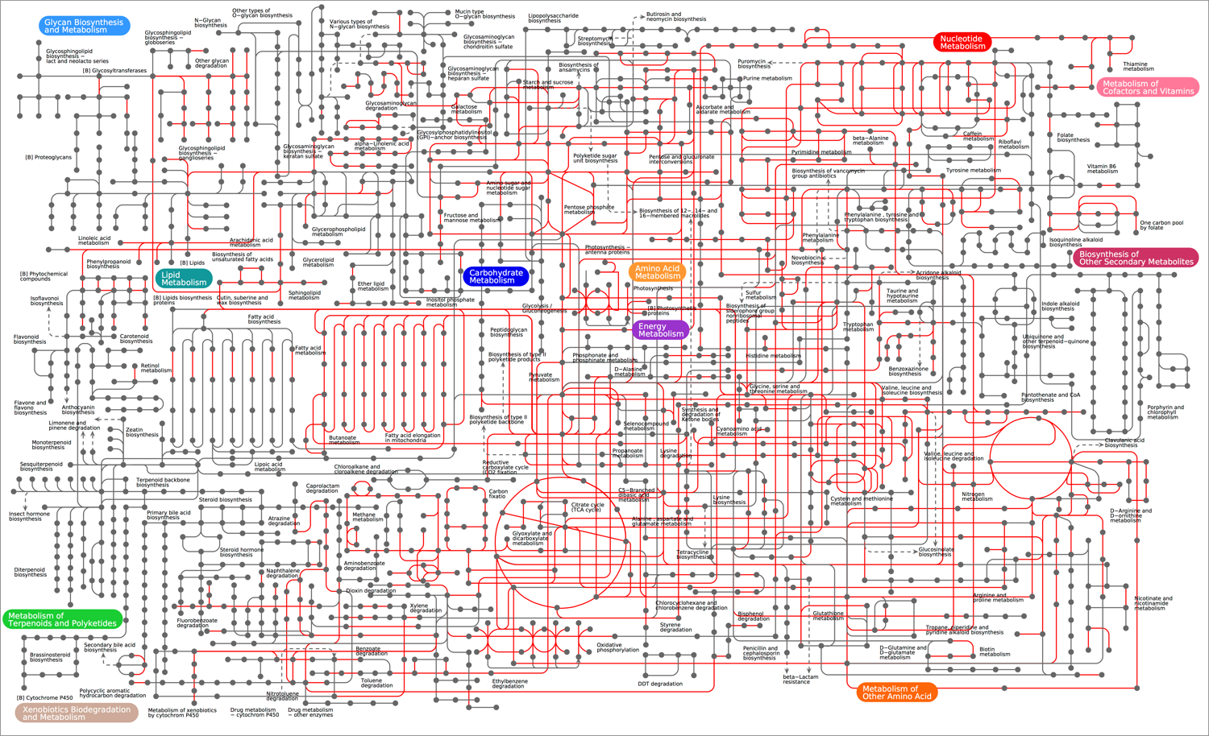
Enzyme limitations in metabolism
Metabolism:
At the core of cellular function
Huge
Highly constrained
Enzyme limitations:
Each metabolic reaction is limited by its corresponding enzyme
Enzymes have different catalytic activities → pathways will have different limitations
We want to model them!

Slide 3
Enzyme limitations in metabolism
Not all pathways have the same limitations!!

Slide 4
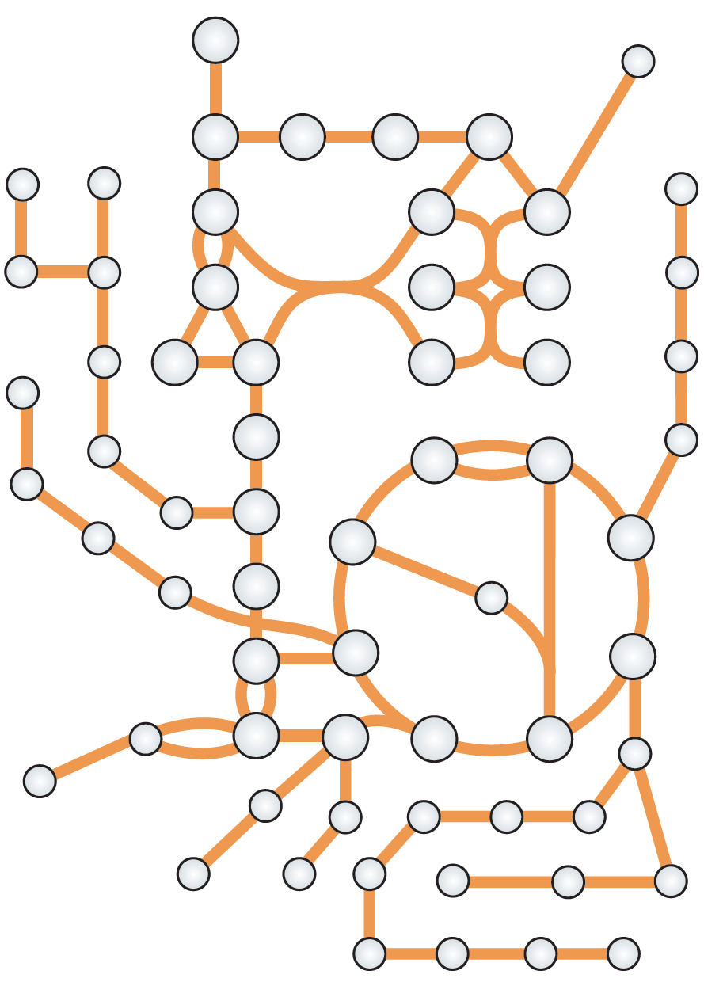
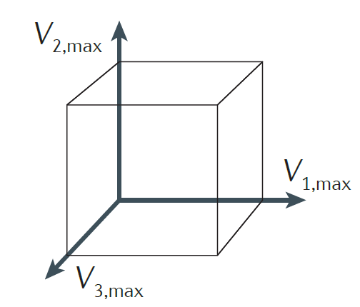
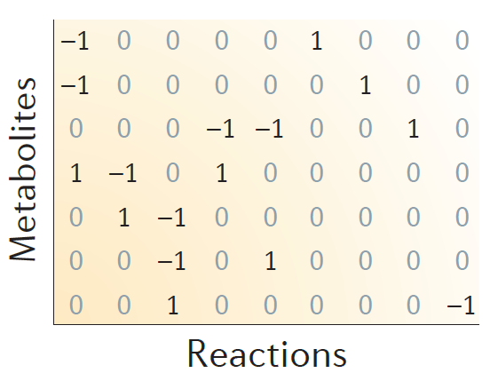
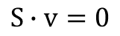
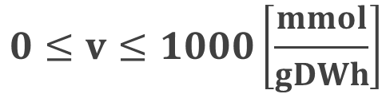
Modeling metabolism
3 easy steps to create a GEnome-scale Model (GEM) of metabolism:
1. Get network
2. Construct stoichiometric matrix (S)
3. Define constraints
$$S∙v=0$$
Some fluxes can be measured experimentally (i.e. exchange fluxes), but for most of them we assume:
$$0≤v≤1000\left[\frac{mmol}{gDWh}\right]$$
Is this realistic?
Notes:
~1000 people/door s

Slide 5
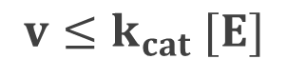
Modeling enzyme limitations in metabolism
Relationship between enzyme and reaction:
Flux of reaction
[mmol/gDWh]
$$v≤k_{cat} [E]$$
Concentration of enzyme [mmol/gDW]
Turnover number [1/h]

Slide 6
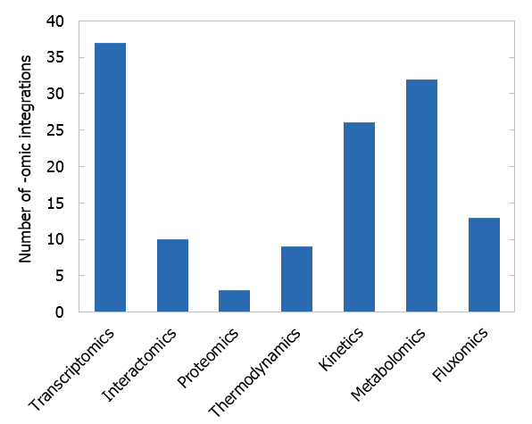
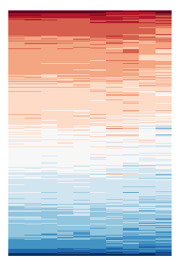
Modeling enzyme limitations in metabolism
Relationship between enzyme and reaction:
Flux of reaction
[mmol/gDWh]
$$v≤k_{cat} [E]$$
Concentration of enzyme [mmol/gDW]
Turnover number [1/h]
However: No available method for directly connecting proteomics to GEMs
Proteomics
Metabolism
Sánchez, B. J., & Nielsen, J. (2015). Integrative Biology, 7(8), 846–858. https://doi.org/10.1039/c5ib00083a

Slide 7
Taking enzymes into account
Nilsson, A., & Nielsen, J. (2016). Scientific Reports, 6. https://doi.org/10.1038/srep22264

Slide 8
Taking enzymes into account
Nilsson, A., & Nielsen, J. (2016). Scientific Reports, 6. https://doi.org/10.1038/srep22264

Slide 9


Taking enzymes into account
Reproducing the Crabtree effect
Metabolic efficiency
(low substrate)
5 GLU + 30 O₂
100 ATP + 30 CO₂
~240 mg of protein
Catalytic efficiency
(Low enzyme)
50 GLU
100 ATP + 100 ETH + 100 CO₂
~120 mg of protein

Slide 10
Going into Genome-Scale

Slide 11

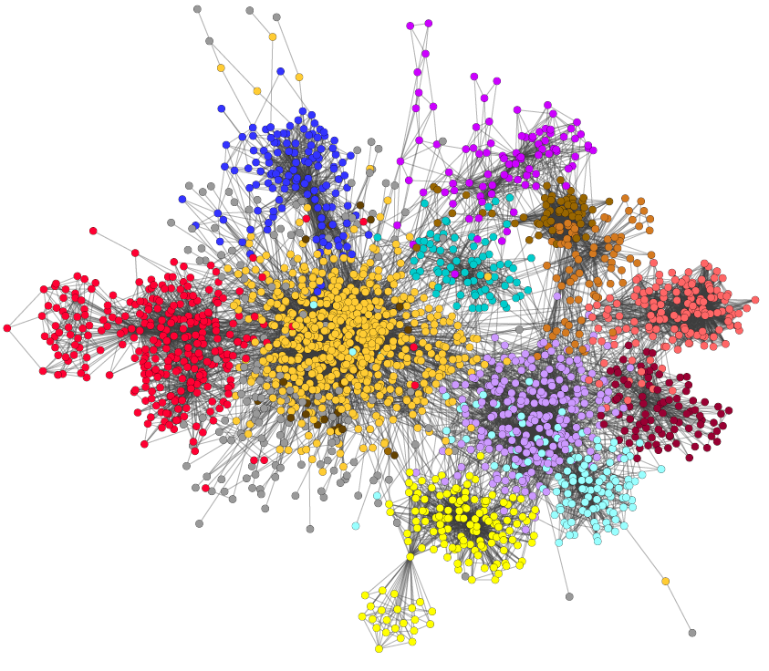
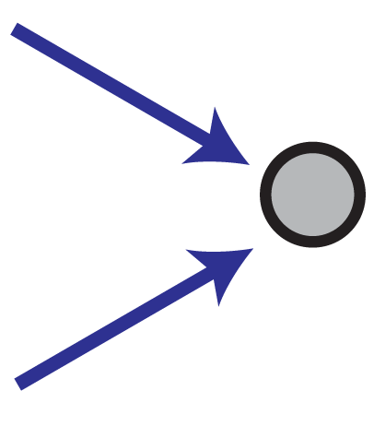


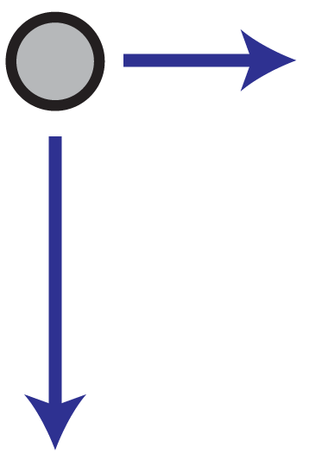
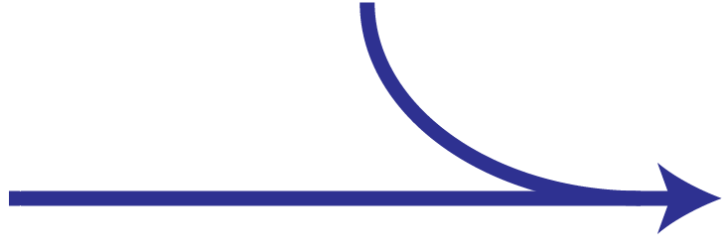

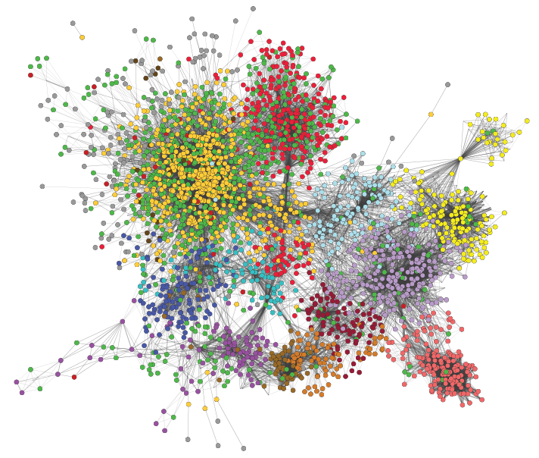

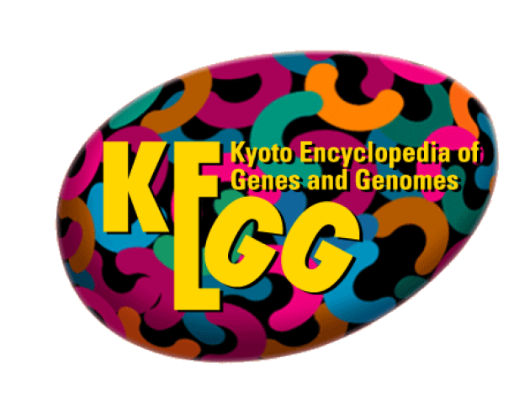


Metabolic model (GEM)
Enzyme usage: e
[mmol/gDW]
e ≤ [E]
E
Enzyme-constrained model
Enzyme data
A
B
Flux: v [mmol/gDWh]
Proteomics
(optional)
New stoichiometry: A + 1/k_{cat} E → B
Mass balance for E: v ≤ k_{cat} · [E]
Sánchez, B. J., Zhang, C., Nilsson, A., Lahtvee, P., Kerkhoven, E. J., & Nielsen, J. (2017). Molecular Systems Biology, 13(8), 935. https://doi.org/10.15252/msb.20167411

Slide 12
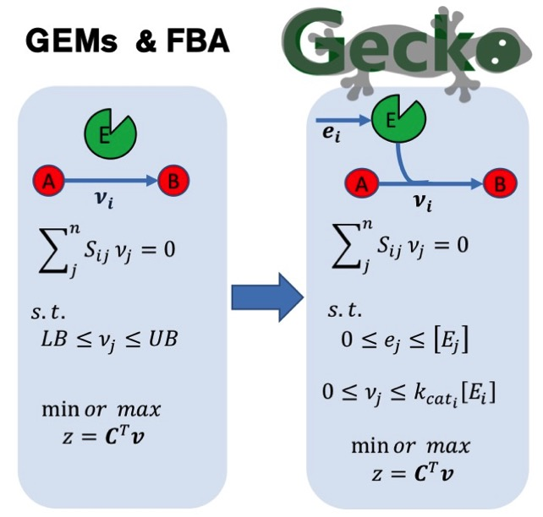
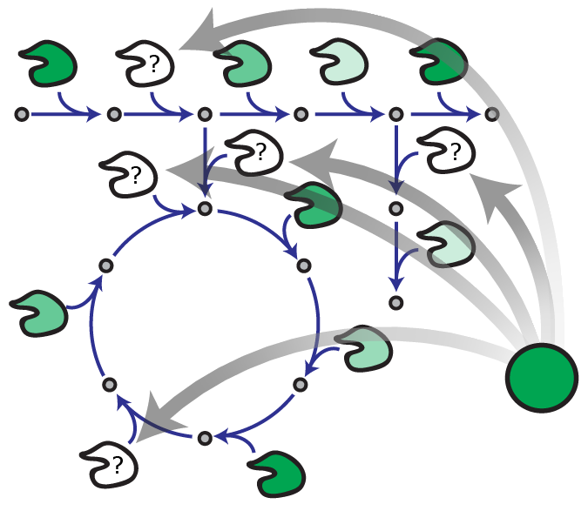
A simple mathematical framework

Slide 13
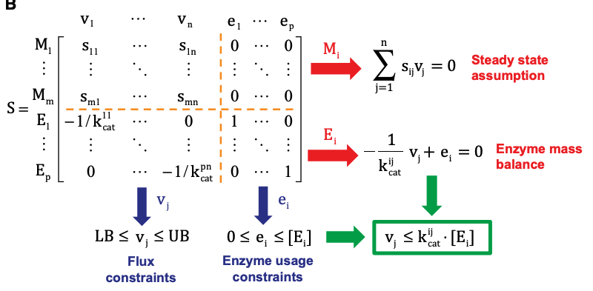
Matrix form

Slide 14
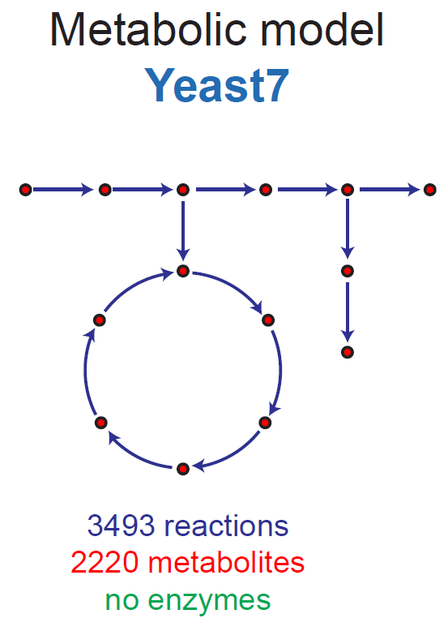
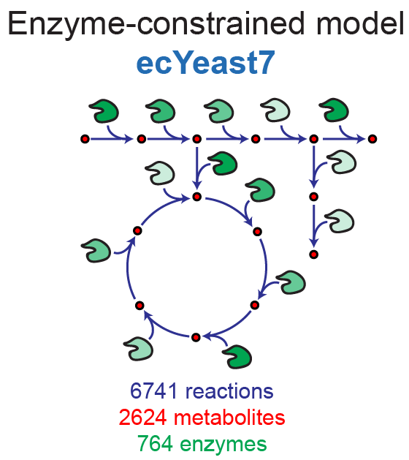

ecYeast7: an improved model of S. cerevisiae

Slide 15
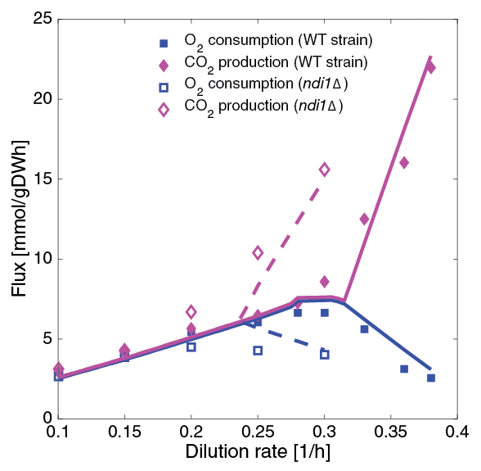
Improving phenotype predictions
Respiration/fermentation switch (in WT and knockout): chemostat simulations
Notes:
NDI1: Rotenone-insensitive NADH-ubiquinone oxidoreductase, mitochondrial.
NADH + ubiquinone = NAD⁺ + ubiquinol

Slide 16
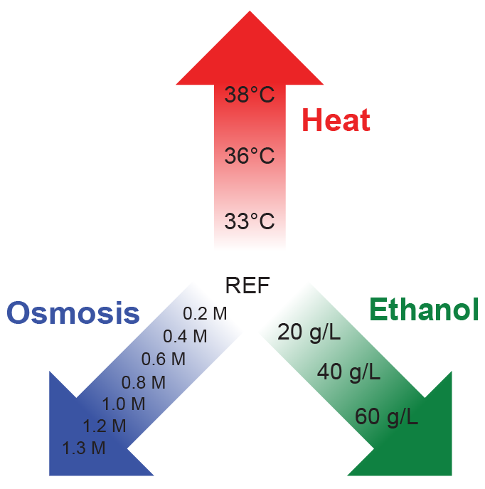
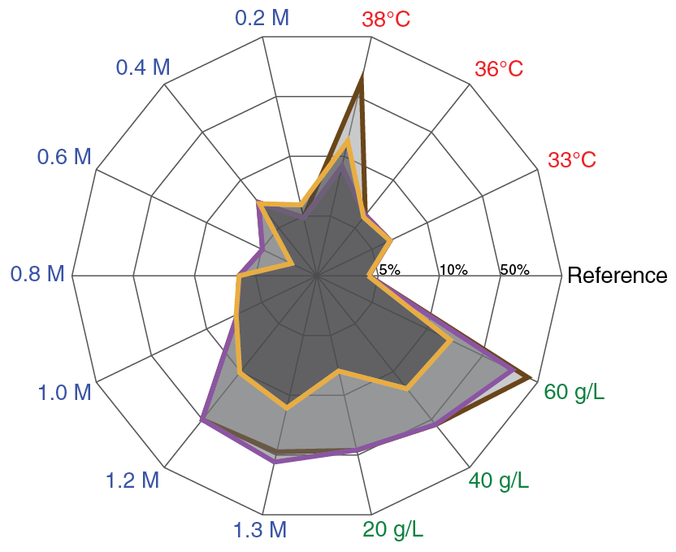
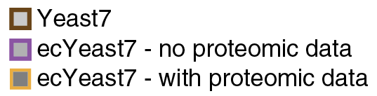
Integrating proteomics
Stress dataset:
S. cerevisiae grown at 14 different stress conditions
Glucose-limited aerobic chemostats @ 0.1 1/h
Proteomic data gathered for each condition
Created condition-specific models:
Error [%] in predicting exchange fluxes:
Notes:
Fitted NGAMs:
Ref: 1 – 1 – 1
33C: 1 – 1 – 1
36C: 1 – 1 – 1
38C: 25 – 31 – 10
0.2M: 1 – 1 – 0
0.4M: 0 – 0 – 0
0.6M: 5 – 5 – 5
0.8M: 6 – 6 – 6
1.0M: 11 – 11 – 7
1.2M: 14 – 14 – 8
1.3M: 15 – 27 – 10
20g/L: 1 – 1 – 3
40g/L: 0 – 0 – 5
60g/L: 0 – 23 – 3

Slide 17
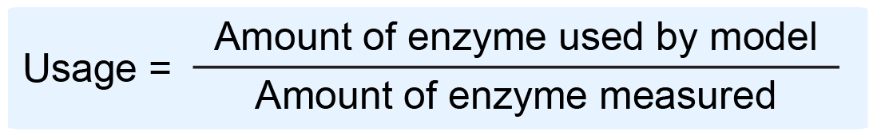
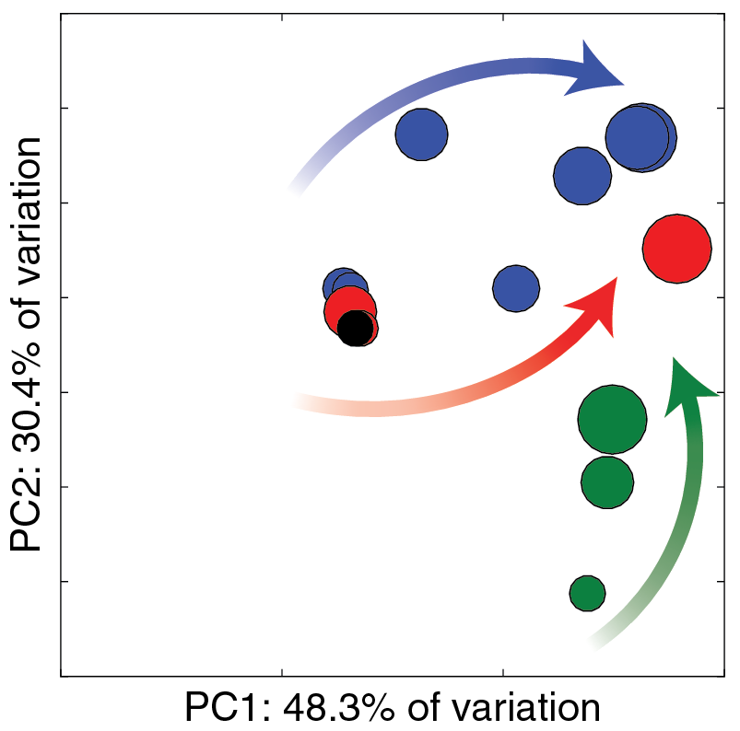
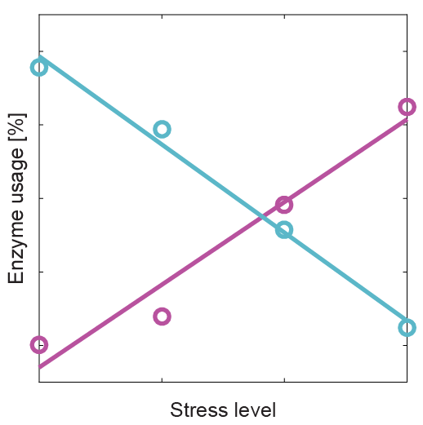
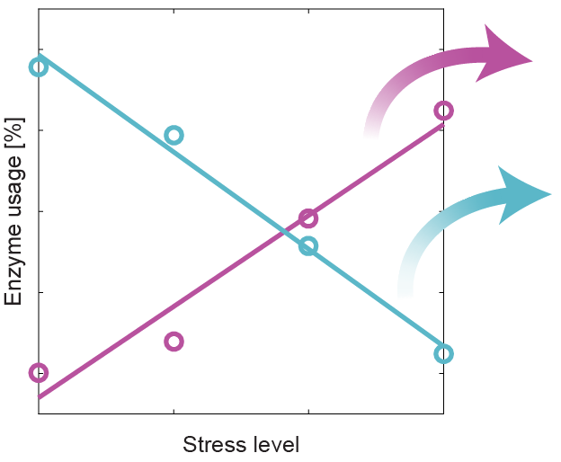
Applications: enzyme usage under stress
Enzyme usage: Can be expressed in absolute terms (mmol/gDW) or as a fraction
General trends
NaCl
Enzyme-specific trends
Increased usage
Heat: LYS21; HIS5; ERG8; ILV3
Osmosis: NDI1; ARO3; CIT1; ILV
Ethanol: MLS1; PYK2; HIS5
Heat
Decreased usage
Heat: GLN4; ADE5,7; UGP1; APA1
Osmosis: ADE5,7; ADE4; ADE2
Ethanol: UGP1
EtOH
Converging trend: Increased CCM and aminoacid degradation
Notes:
Filter: |correlation| > 0.95, m > 0.1, max(usage) > 1%
Increase Heat:
LYS21: L-lysine synthesis (Homocitrate synthase, mitochondrial )
HIS5: L-histidine synthesis (Histidinol-phosphate aminotransferase)
ERG8;13: Ergosterol synthesis (Phosphomevalonate kinase; HMG-CoA synthase)
ILV3;5: L-isoleucine synthesis (Dihydroxy-acid dehydratase; Ketol-acid reductoisomerase)
Decrease Heat:
GLN4: Glutamine--tRNA ligase (ATP + L-glutamine + tRNA(Gln) = AMP + diphosphate + L-glutaminyl-tRNA(Gln))
ADE5,7: IMP biosynthesis via de novo pathway (bifunctional purine biosynthetic protein))
UGP1: carbohydrate synthesis (UTP + alpha-D-glucose 1-phosphate = diphosphate + UDP-glucose)
APA1: ADP + ATP = phosphate + P₁,P(4)-bis(5'-adenosyl) tetraphosphate
Increase Osmosis:
NDI1: “Complex I”, NADH-ubiquinone oxidoreductase, mitochondrial (NADH + ubiquinone = NAD⁺ + ubiquinol)
ARO3: 1st step aromatic synthesis (PEP+ D-ery 4P + H₂O = 3-deoxy-D-arabino-hept-2-ulosonate 7P + P)
CIT1: Citrate synthase (Acetyl-CoA + H₂O + oxaloacetate = citrate + CoA)
ILV2;5: L-isoleucine synthesis (Acetolactate synthase; Ketol-acid reductoisomerase)
Decrease Osmosis:
ADE: IMP biosynthesis via de novo pathway:
ADE2: P-ribosylaminoimidazole carboxylase
ADE4: amido-P-ribosyltransferase
ADE5,7: bifunctional purine biosynthetic protein)
Increase Ethanol:
MLS1: TCA (Malate synthase)
PYK2: Pyruvate kinase (ATP + pyruvate = ADP + PEP)
HIS5: L-histidine synthesis (Histidinol-phosphate aminotransferase)
Decrease Ethanol:
UGP1: carbohydrate synthesis (UTP + alpha-D-glucose 1-phosphate = diphosphate + UDP-glucose)

Slide 18
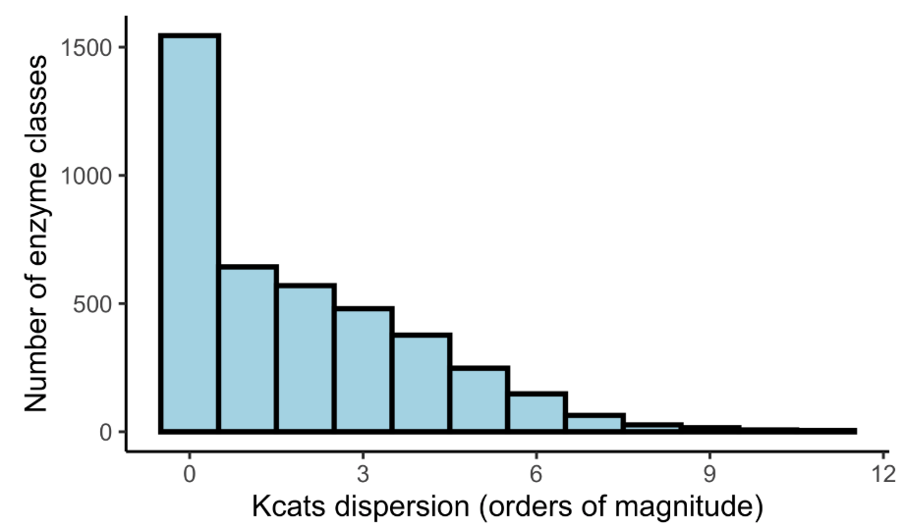
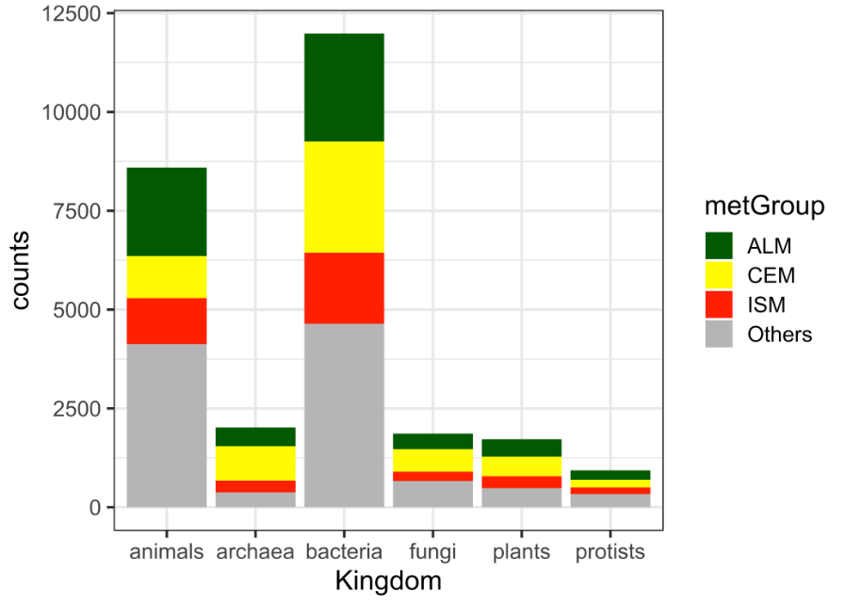

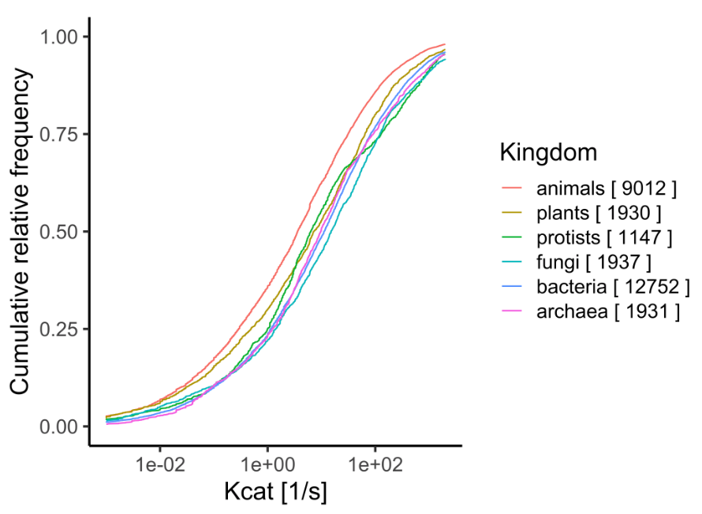
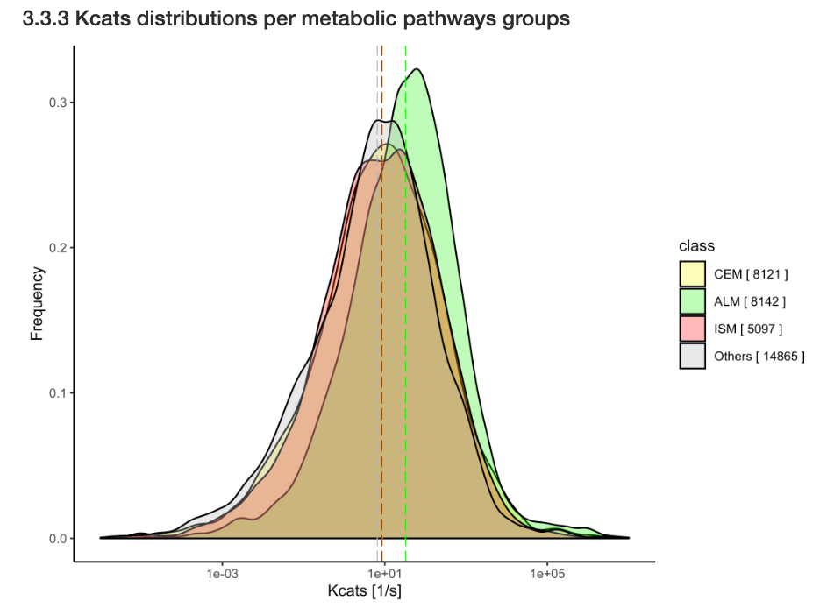
OK for yeast, but what about other bugs?
Notes:
Filter: |correlation| > 0.95, m > 0.1, max(usage) > 1%
Increase Heat:
LYS21: L-lysine synthesis (Homocitrate synthase, mitochondrial )
HIS5: L-histidine synthesis (Histidinol-phosphate aminotransferase)
ERG8;13: Ergosterol synthesis (Phosphomevalonate kinase; HMG-CoA synthase)
ILV3;5: L-isoleucine synthesis (Dihydroxy-acid dehydratase; Ketol-acid reductoisomerase)
Decrease Heat:
GLN4: Glutamine--tRNA ligase (ATP + L-glutamine + tRNA(Gln) = AMP + diphosphate + L-glutaminyl-tRNA(Gln))
ADE5,7: IMP biosynthesis via de novo pathway (bifunctional purine biosynthetic protein))
UGP1: carbohydrate synthesis (UTP + alpha-D-glucose 1-phosphate = diphosphate + UDP-glucose)
APA1: ADP + ATP = phosphate + P₁,P(4)-bis(5'-adenosyl) tetraphosphate
Increase Osmosis:
NDI1: “Complex I”, NADH-ubiquinone oxidoreductase, mitochondrial (NADH + ubiquinone = NAD⁺ + ubiquinol)
ARO3: 1st step aromatic synthesis (PEP+ D-ery 4P + H₂O = 3-deoxy-D-arabino-hept-2-ulosonate 7P + P)
CIT1: Citrate synthase (Acetyl-CoA + H₂O + oxaloacetate = citrate + CoA)
ILV2;5: L-isoleucine synthesis (Acetolactate synthase; Ketol-acid reductoisomerase)
Decrease Osmosis:
ADE: IMP biosynthesis via de novo pathway:
ADE2: P-ribosylaminoimidazole carboxylase
ADE4: amido-P-ribosyltransferase
ADE5,7: bifunctional purine biosynthetic protein)
Increase Ethanol:
MLS1: TCA (Malate synthase)
PYK2: Pyruvate kinase (ATP + pyruvate = ADP + PEP)
HIS5: L-histidine synthesis (Histidinol-phosphate aminotransferase)
Decrease Ethanol:
UGP1: carbohydrate synthesis (UTP + alpha-D-glucose 1-phosphate = diphosphate + UDP-glucose)

Slide 19
OK for yeast, but what about other bugs?
Lessons from BRENDA
K_{cat} values are heterogeneously available and show a extremely high variability amongst organisms and metabolic contexts, limiting the applicability of the original method to other GEMs.
Notes:
Filter: |correlation| > 0.95, m > 0.1, max(usage) > 1%
Increase Heat:
LYS21: L-lysine synthesis (Homocitrate synthase, mitochondrial )
HIS5: L-histidine synthesis (Histidinol-phosphate aminotransferase)
ERG8;13: Ergosterol synthesis (Phosphomevalonate kinase; HMG-CoA synthase)
ILV3;5: L-isoleucine synthesis (Dihydroxy-acid dehydratase; Ketol-acid reductoisomerase)
Decrease Heat:
GLN4: Glutamine--tRNA ligase (ATP + L-glutamine + tRNA(Gln) = AMP + diphosphate + L-glutaminyl-tRNA(Gln))
ADE5,7: IMP biosynthesis via de novo pathway (bifunctional purine biosynthetic protein))
UGP1: carbohydrate synthesis (UTP + alpha-D-glucose 1-phosphate = diphosphate + UDP-glucose)
APA1: ADP + ATP = phosphate + P₁,P(4)-bis(5'-adenosyl) tetraphosphate
Increase Osmosis:
NDI1: “Complex I”, NADH-ubiquinone oxidoreductase, mitochondrial (NADH + ubiquinone = NAD⁺ + ubiquinol)
ARO3: 1st step aromatic synthesis (PEP+ D-ery 4P + H₂O = 3-deoxy-D-arabino-hept-2-ulosonate 7P + P)
CIT1: Citrate synthase (Acetyl-CoA + H₂O + oxaloacetate = citrate + CoA)
ILV2;5: L-isoleucine synthesis (Acetolactate synthase; Ketol-acid reductoisomerase)
Decrease Osmosis:
ADE: IMP biosynthesis via de novo pathway:
ADE2: P-ribosylaminoimidazole carboxylase
ADE4: amido-P-ribosyltransferase
ADE5,7: bifunctional purine biosynthetic protein)
Increase Ethanol:
MLS1: TCA (Malate synthase)
PYK2: Pyruvate kinase (ATP + pyruvate = ADP + PEP)
HIS5: L-histidine synthesis (Histidinol-phosphate aminotransferase)
Decrease Ethanol:
UGP1: carbohydrate synthesis (UTP + alpha-D-glucose 1-phosphate = diphosphate + UDP-glucose)

Slide 20

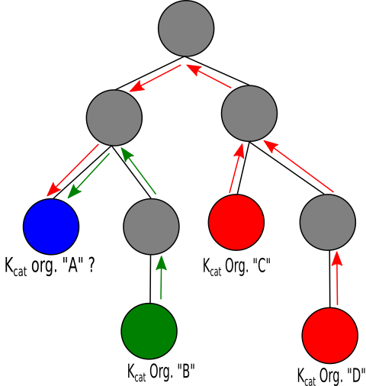
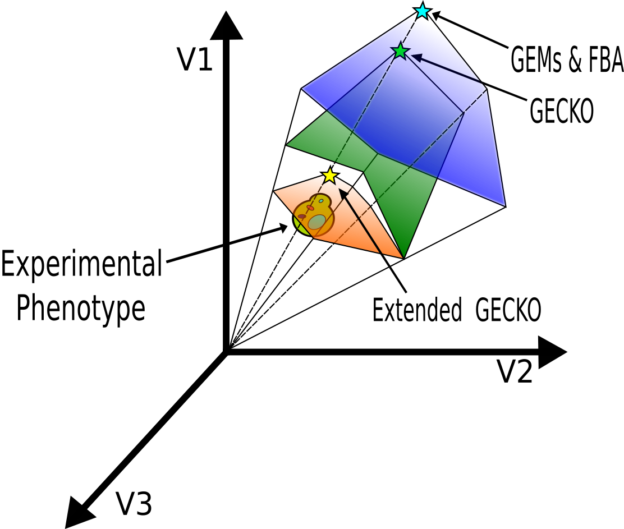

Moving forward
Automatic generation of functional and calibrated ecModel for any organism for which a GEM is available with minimal human intervention
Notes:
Filter: |correlation| > 0.95, m > 0.1, max(usage) > 1%
Increase Heat:
LYS21: L-lysine synthesis (Homocitrate synthase, mitochondrial )
HIS5: L-histidine synthesis (Histidinol-phosphate aminotransferase)
ERG8;13: Ergosterol synthesis (Phosphomevalonate kinase; HMG-CoA synthase)
ILV3;5: L-isoleucine synthesis (Dihydroxy-acid dehydratase; Ketol-acid reductoisomerase)
Decrease Heat:
GLN4: Glutamine--tRNA ligase (ATP + L-glutamine + tRNA(Gln) = AMP + diphosphate + L-glutaminyl-tRNA(Gln))
ADE5,7: IMP biosynthesis via de novo pathway (bifunctional purine biosynthetic protein))
UGP1: carbohydrate synthesis (UTP + alpha-D-glucose 1-phosphate = diphosphate + UDP-glucose)
APA1: ADP + ATP = phosphate + P₁,P(4)-bis(5'-adenosyl) tetraphosphate
Increase Osmosis:
NDI1: “Complex I”, NADH-ubiquinone oxidoreductase, mitochondrial (NADH + ubiquinone = NAD⁺ + ubiquinol)
ARO3: 1st step aromatic synthesis (PEP+ D-ery 4P + H₂O = 3-deoxy-D-arabino-hept-2-ulosonate 7P + P)
CIT1: Citrate synthase (Acetyl-CoA + H₂O + oxaloacetate = citrate + CoA)
ILV2;5: L-isoleucine synthesis (Acetolactate synthase; Ketol-acid reductoisomerase)
Decrease Osmosis:
ADE: IMP biosynthesis via de novo pathway:
ADE2: P-ribosylaminoimidazole carboxylase
ADE4: amido-P-ribosyltransferase
ADE5,7: bifunctional purine biosynthetic protein)
Increase Ethanol:
MLS1: TCA (Malate synthase)
PYK2: Pyruvate kinase (ATP + pyruvate = ADP + PEP)
HIS5: L-histidine synthesis (Histidinol-phosphate aminotransferase)
Decrease Ethanol:
UGP1: carbohydrate synthesis (UTP + alpha-D-glucose 1-phosphate = diphosphate + UDP-glucose)

Slide 21
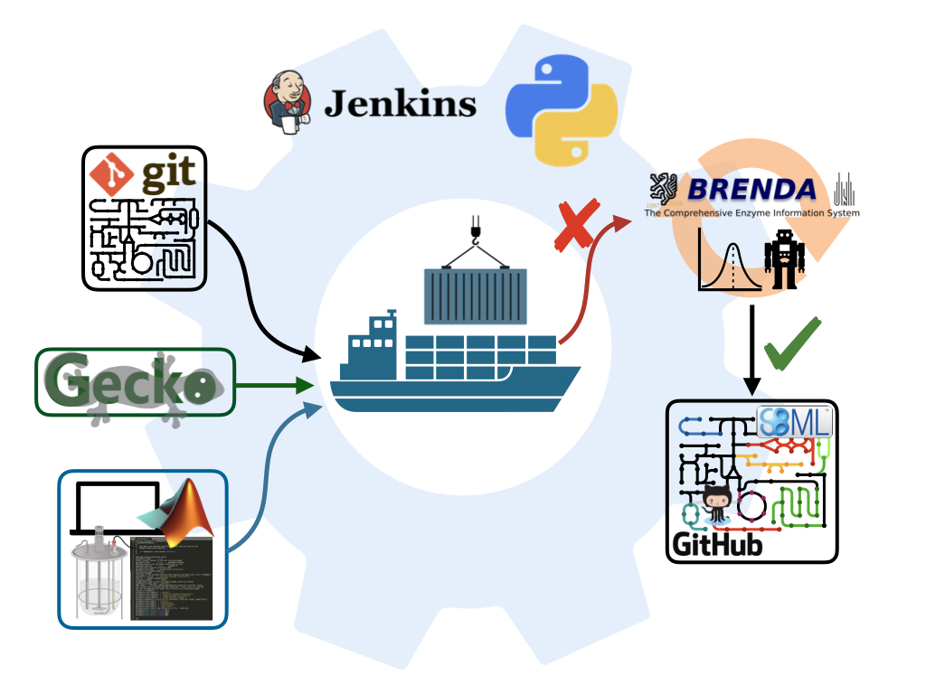
Moving forward: ecModels container
https://github.com/SysBioChalmers/ecModels
Notes:
Filter: |correlation| > 0.95, m > 0.1, max(usage) > 1%
Increase Heat:
LYS21: L-lysine synthesis (Homocitrate synthase, mitochondrial )
HIS5: L-histidine synthesis (Histidinol-phosphate aminotransferase)
ERG8;13: Ergosterol synthesis (Phosphomevalonate kinase; HMG-CoA synthase)
ILV3;5: L-isoleucine synthesis (Dihydroxy-acid dehydratase; Ketol-acid reductoisomerase)
Decrease Heat:
GLN4: Glutamine--tRNA ligase (ATP + L-glutamine + tRNA(Gln) = AMP + diphosphate + L-glutaminyl-tRNA(Gln))
ADE5,7: IMP biosynthesis via de novo pathway (bifunctional purine biosynthetic protein))
UGP1: carbohydrate synthesis (UTP + alpha-D-glucose 1-phosphate = diphosphate + UDP-glucose)
APA1: ADP + ATP = phosphate + P₁,P(4)-bis(5'-adenosyl) tetraphosphate
Increase Osmosis:
NDI1: “Complex I”, NADH-ubiquinone oxidoreductase, mitochondrial (NADH + ubiquinone = NAD⁺ + ubiquinol)
ARO3: 1st step aromatic synthesis (PEP+ D-ery 4P + H₂O = 3-deoxy-D-arabino-hept-2-ulosonate 7P + P)
CIT1: Citrate synthase (Acetyl-CoA + H₂O + oxaloacetate = citrate + CoA)
ILV2;5: L-isoleucine synthesis (Acetolactate synthase; Ketol-acid reductoisomerase)
Decrease Osmosis:
ADE: IMP biosynthesis via de novo pathway:
ADE2: P-ribosylaminoimidazole carboxylase
ADE4: amido-P-ribosyltransferase
ADE5,7: bifunctional purine biosynthetic protein)
Increase Ethanol:
MLS1: TCA (Malate synthase)
PYK2: Pyruvate kinase (ATP + pyruvate = ADP + PEP)
HIS5: L-histidine synthesis (Histidinol-phosphate aminotransferase)
Decrease Ethanol:
UGP1: carbohydrate synthesis (UTP + alpha-D-glucose 1-phosphate = diphosphate + UDP-glucose)

Slide 22
A collection of ecModels
Enzymes coverage varies due to differences in functional annotation.

Slide 23
Reducing the solution space - FVA
-Median flux variability reduced in orders magnitude
-Number of totally variable fluxes is drastically reduced

Slide 24
Reducing the solution space - FVA
K. marxianus
1
-
0.75
Model
ecModel
0.5
0.25
0
10⁻²
10⁰
10²

Slide 25
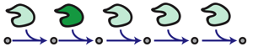
Applications: exploring mutant phenotypes
Gene deletions
Gene overexpressions
ecModels provide a natural framework for the exploration of enzymes deletion and overexpression effects on metabolism

Slide 26
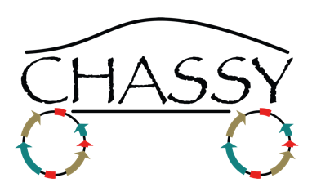
Applications: exploring mutant phenotypes
Complex enzyme(s)-rxn(s) relationships are taken into account
Optimal expression levels for production targets can be assessed.
Gene deletions
Gene overexpressions

Slide 27
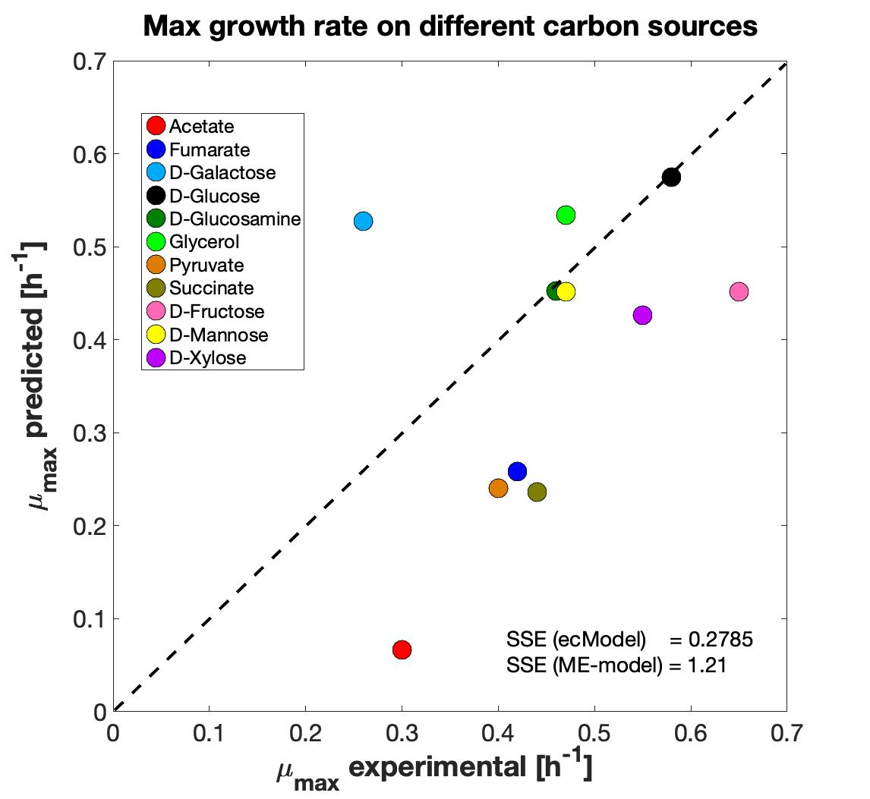
Applications: growth on diverse environments
E. coli
S. cerevisiae
E. coli
Total protein prediction
[g prot/gDw]
ecModels protein allocation compared to ME models
Growth predictions on diverse environments

Slide 28
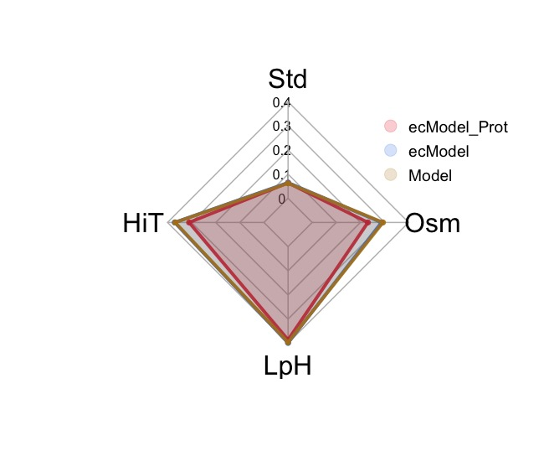
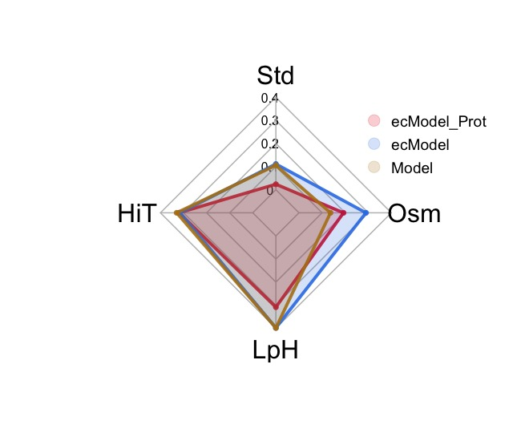
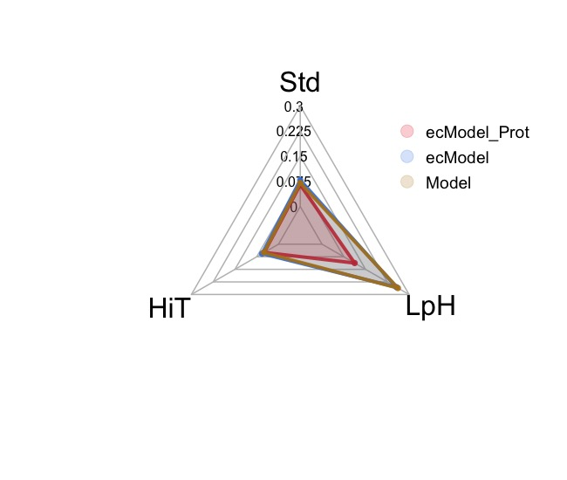
Applications: analyzing stress responses
Improving phenotype predictions by the addition of proteomics data for multiple conditions
S. cerevisiae
K. marxianus
Y. lipolytica
*Median relative error in exchange fluxes prediction

Slide 29
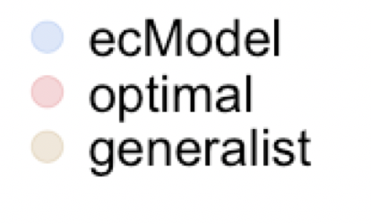
Escherichia coli: eciML1515
S. cerevisiae
E. coli
E. coli
Total protein prediction
[g prot/gDw]
Growth predictions on diverse environments
ecModels protein allocation compared to ME models

Slide 30
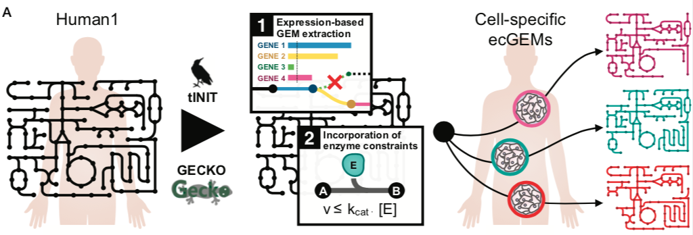
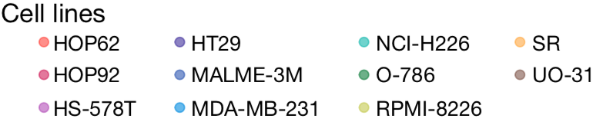
Human cell lines

Slide 31
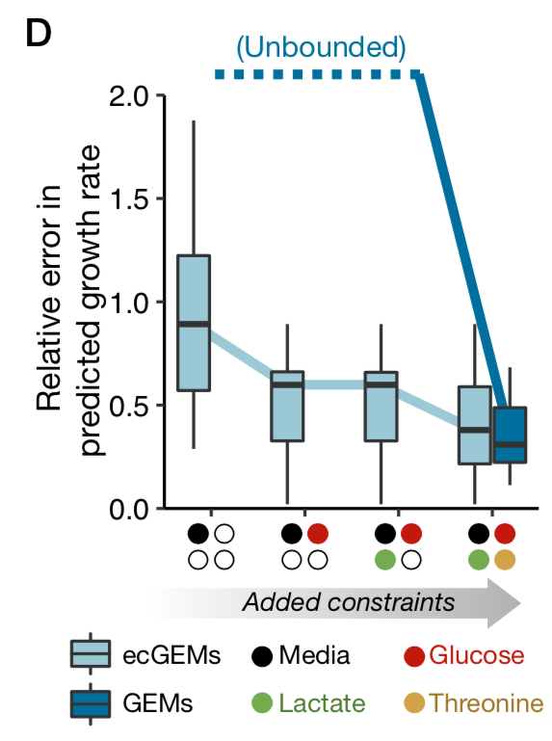
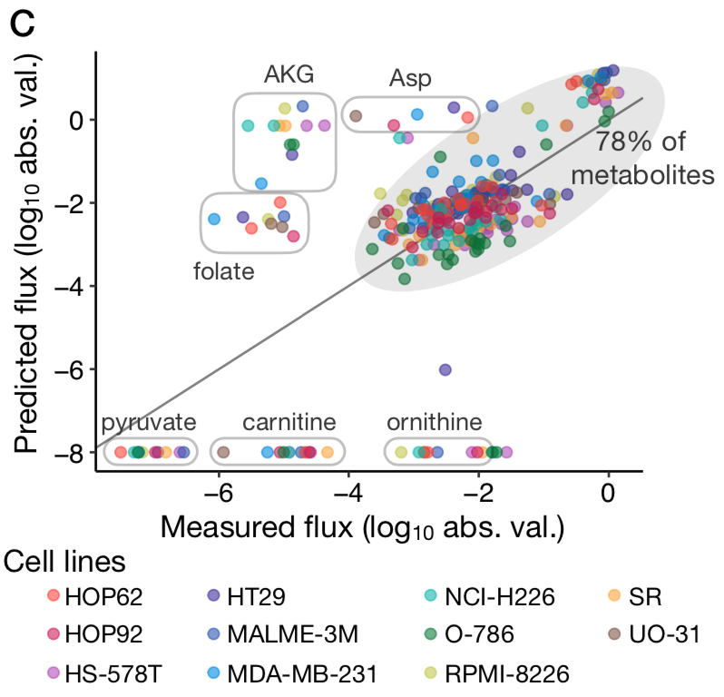
Human cell lines

Slide 32
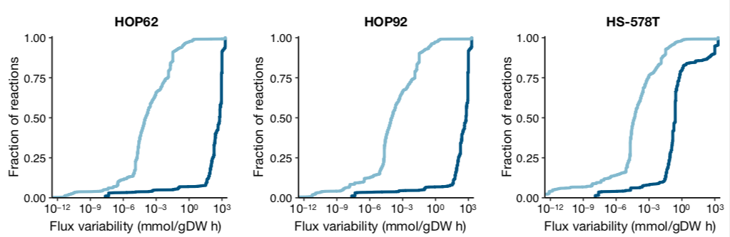
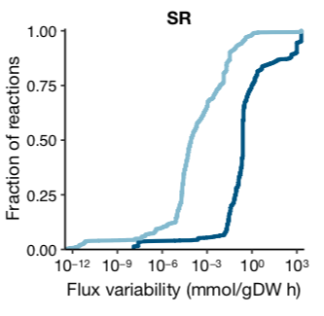
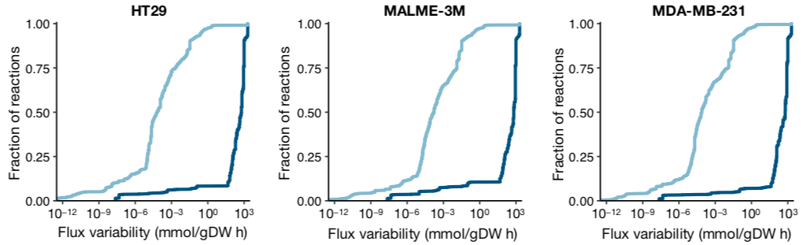
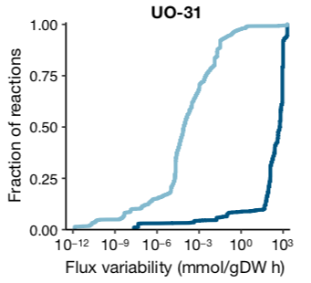


Human cell lines

Slide 33


ecModels for prediction of metabolic engineering targets
FSEOF
+
Enzyme usage
variability analysis
+
Mechanistic
modifications
+
Redundancy assessment
& priotirization
65 genes
60 genes
49 genes
23 genes
Heme accumulation in S. cerevisiae

Slide 34




Naringenin production
Find optimal naringenin producer strains
ecYeast8
eciYali4
ecKmx
Robust ecFSEOF
Utilities
add_ecPathway

Slide 35

Naringenin production:
Over expressions
ARO4
PDC1
ALD6
NCE103
ACC1
ARO1
ARO7
PHA2
ARO2
BPL1
YALI0F05962g
YALI0D07942g
TKL1

Slide 36

Naringenin production:
Deletions

Slide 37
Hassing, E. J., de Groot, P. A., Marquenie, V. R., Pronk, J. T., & Daran, J. M. G. (2019). Connecting central carbon and aromatic amino acid metabolisms to improve de novo 2-phenylethanol production in Saccharomyces cerevisiae. Metabolic Engineering, 56, 165–180. https://doi.org/10.1016/j.ymben.2019.09.011

Slide 38






Evaluating absolute proteomics methods for integration into ecModels

Slide 39

Evaluating absolute proteomics methods for integration into ecModels
Estimation of known concentrations

Slide 40
Evaluating absolute proteomics methods for integration into ecModels
Estimation of known concentrations

Slide 41
Evaluating absolute proteomics methods for integration into ecModels
Estimation of known concentrations

Slide 42


Evaluating absolute proteomics methods for integration into ecModels
Estimation of known concentrations

Slide 43
Conclusions
GECKO has been enhanced to be able to deal with GEMs for any organism
ecModels container was developed for automated and continuous generation and update of a full catalogue of ecModels
Enzyme constraints reduce the need for context-specific constraints for phenotypes predictions
ecModels provide a scaffold for the study of proteomics data in a metabolic context

Slide 44



Our computational tools are available at:
https://github.com/SysBioChalmers/GECKO
https://github.com/SysBioChalmers/ecModels
Contributions are very welcome!

